Slide 1
Predict diabetes whether a person will have or not USING KNN ALGORITHM
NAME: AMAYA SREENIVASAN
ENROLLMENT NO:EBEONO322582139

Slide 2
What’s in it for you
Why do we need KNN?
What is KNN?
When do we use KNN Algorithm?
Use Case: Predict diabetes

Slide 3
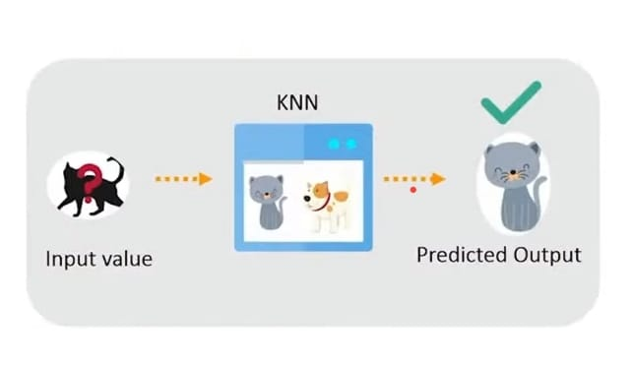
Why KNN?
KNN is based on features similarity, we can do classification using KNN classifier.

Slide 4
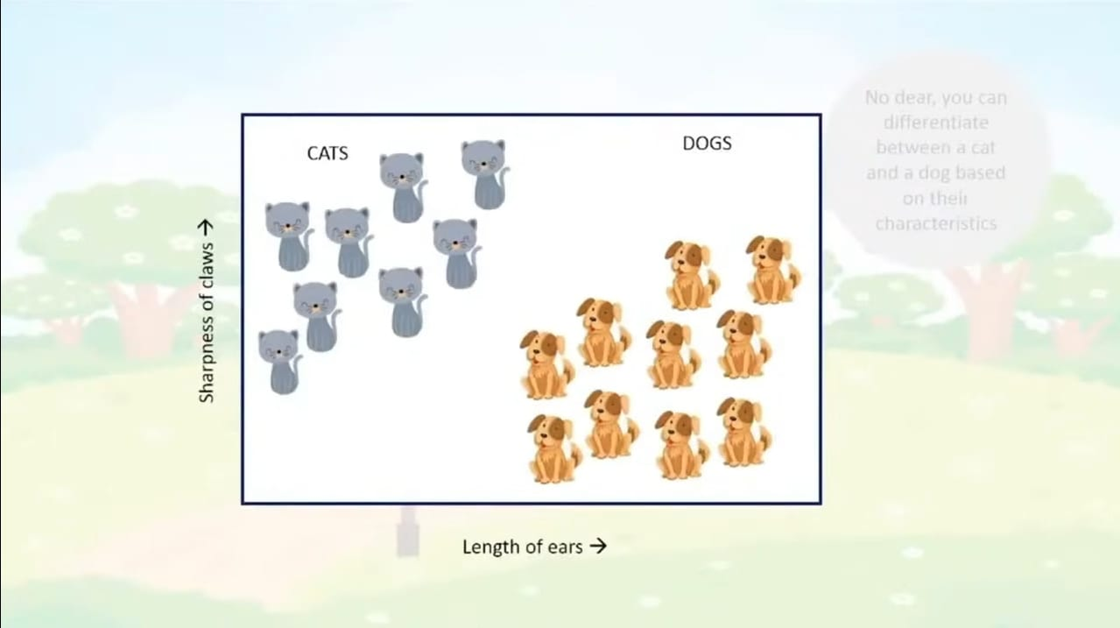
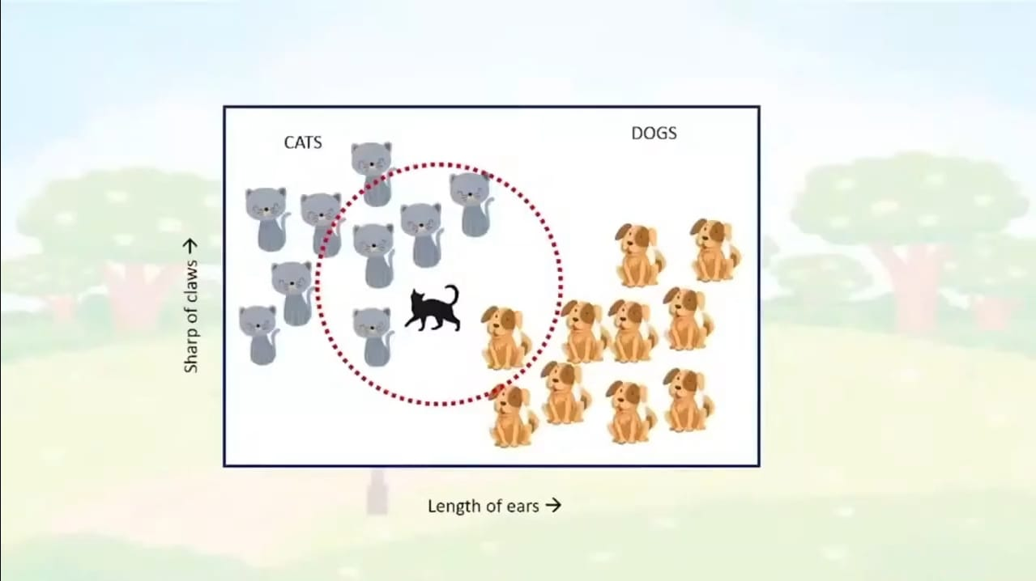
We can identify by there features

Slide 5
What is KNN?
KNN- K Nearest Neighbors is one of the simplest supervised machine learning algorithm .
KNN stores all available cases and classifies new cases based on similarity measure.
K is KNN is a parameter that refers to the number of nearset neighbors to include in the majority voting process.

Slide 6
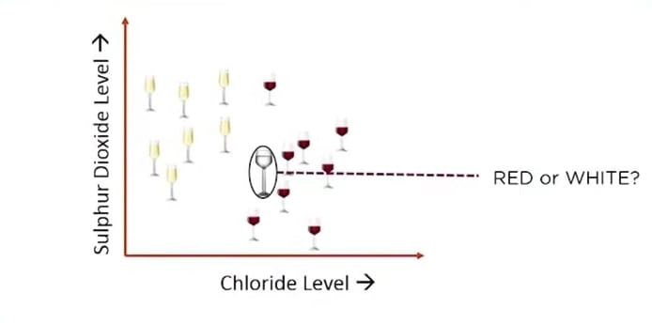
What is KNN algorithm

Slide 7
When do we use KNN algorithm
We can use KNN when data is labeled
When data is noise free

Slide 8
USE CASE-PREDICT DIABETES
OBJECTIVE: predict whether a person will be diagnosed with diabetes or not.
We have 769 people who have were or were not diagnosed with diabetes

Slide 9
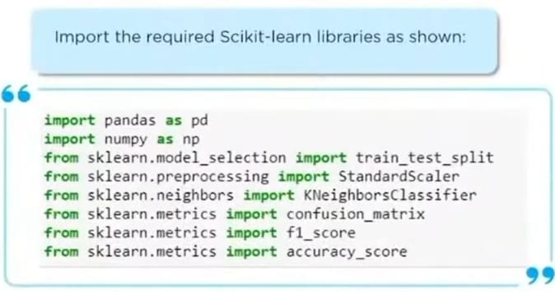

Slide 10
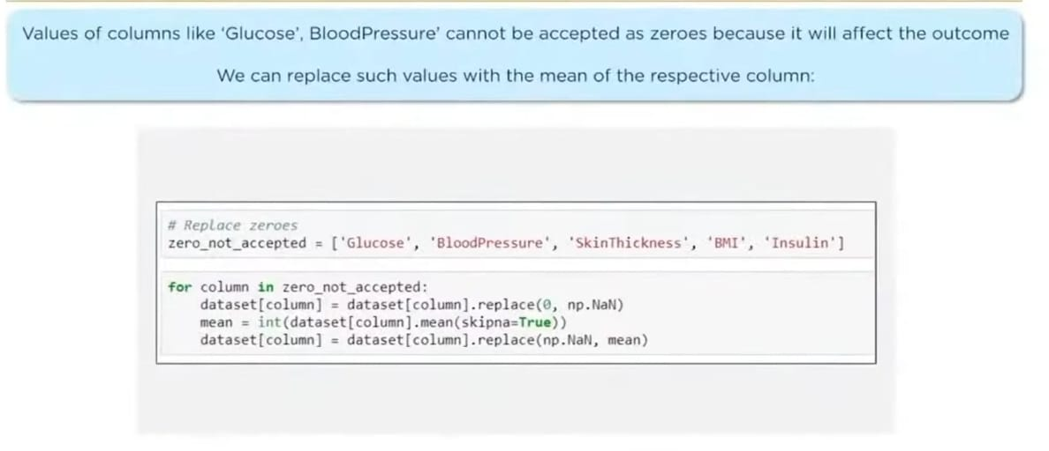

Slide 11
Print(accuracy_score(y_test, y_pred)) 0.81818181818182
And accuracy of 80% tells us that it is a pretty fair fit in the model.

Slide 12
Thank you

